Slide 1
Face-Spoofing 2D Detection
using Moire’s Pattern

Slide 2
Detecting Fake Videos
Carine Bhardwaj
219302344 , IT- 6D
Shaik Chashur
219302359, IT- 6D
Under the Guidance of Dr. Shalini Puri

Slide 3
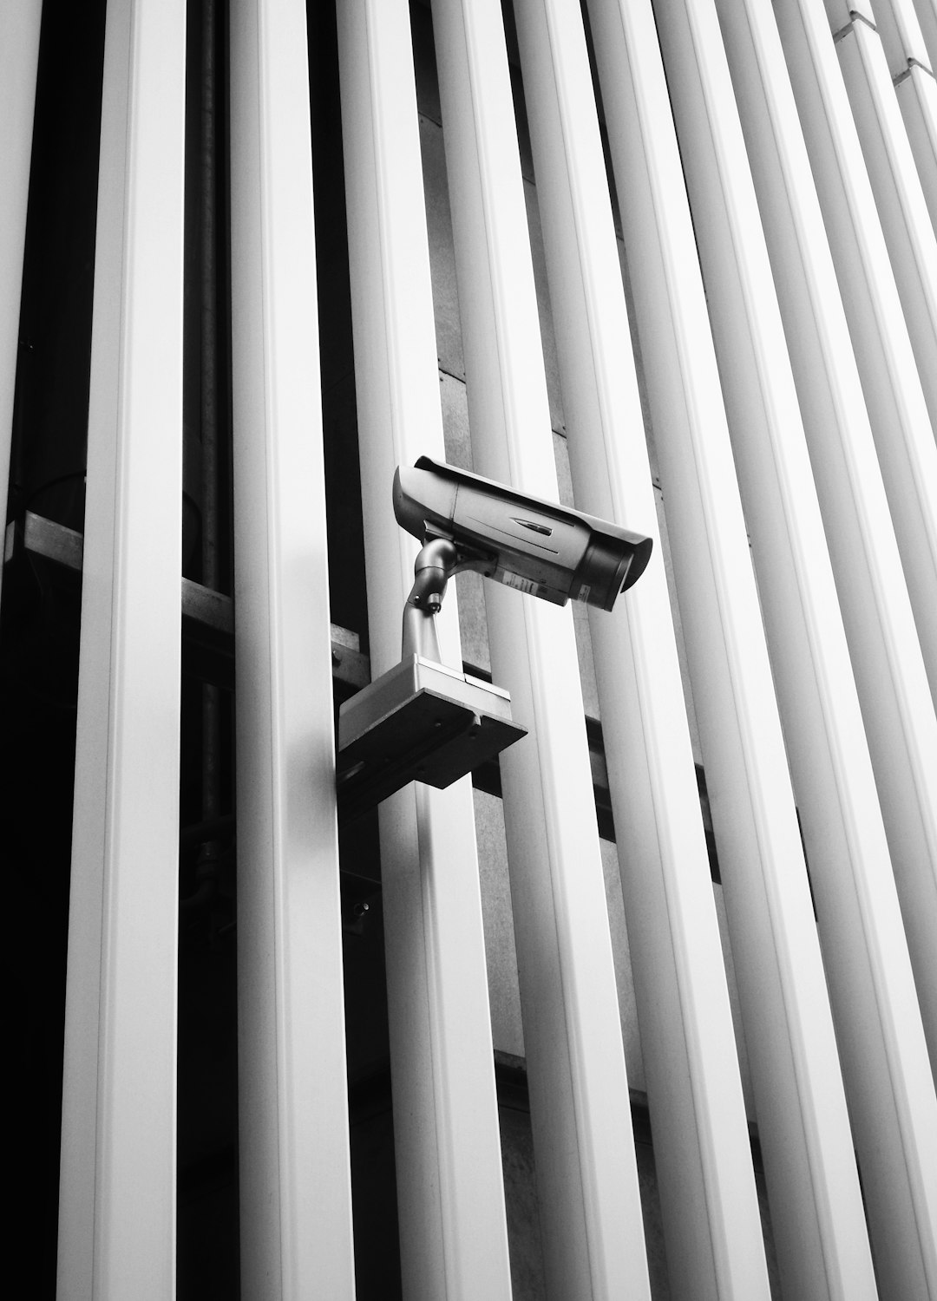
Detecting and accepting real videos is crucial in today's era of video manipulation.

Slide 4

Face spoofing
Face spoofing is a type of biometric attack where an individual attempts to deceive a facial recognition system by presenting a fake or manipulated image or video of another person’s face.
This can be done to gain unauthorized access to a system, steal someone’s identity, or commit fraudulent activities

Slide 5
Types in face spoofing
Presentation Attack: This involves presenting a fake or manipulated image or video of a person’s face to the facial recognition system
It's when someone tries to trick a facial recognition system by presenting fake or manipulated data.
The aim is to make the system think the attacker is an authorized user.

Slide 6
Types of Attacks
Problem
-Printed Photographs: Using high-quality printed photos of an authorized user.
- Replay Attacks: Playing back prerecorded videos or images of an authorized user's face.
- 3D Masks: Creating lifelike masks to bypass facial recognition.
- Digital Manipulation: Altering images or videos of an authorized user's face.
Impact
- Successful attacks can lead to unauthorized access, data breaches, and compromised security.
- Presentation attacks are a serious threat in security systems relying on facial recognition.

Slide 7
Impersonation Attacks
1. Definition:
- An impersonation attack involves pretending to be someone else to gain unauthorized access or privileges.
2. In Facial Recognition:
- In facial recognition, it means presenting someone else's face to trick the system into granting access.
3. Methods:
- Social Engineering: Persuading or manipulating someone to give up their credentials or access.
- Spoofing Techniques: Using fake biometric data or manipulated images to impersonate someone.
4. Detection and Prevention:
- Multifactor Authentication: Adding extra layers of verification beyond facial recognition.
- Behavioral Analysis: Monitoring user behavior for suspicious activity during authentication.
- Training and Awareness: Educating users to recognize and report impersonation attempts.
5. Consequences:
- Successful impersonation attacks can lead to unauthorized access, data breaches, and compromised security.
- They pose significant risks to systems relying on facial recognition for access control or authentication.

Slide 8

Digital image
digital image forensics involves the investigation and analysis of digital images to uncover information about their origin, authenticity, or any manipulations they may have undergone. It's like detective work for images, where experts use various techniques to examine photos or videos to determine if they've been altered, identify where they came from, or verify their authenticity

Slide 9
• PRNU is a unique fingerprint-like pattern inherent in digital image sensors due to manufacturing variations and imperfections.
• It arises from microscopic differences in the photo-response of individual sensor elements to light.
• PRNU can be extracted from images captured by the camera and used as a form of digital watermark or fingerprint to identify the specific camera that captured an image.
• Forensic analysis techniques can detect PRNU patterns in images, enabling the verification of image authenticity or determining whether an image has been manipulated.
PRNU : PhotoResponseNonUniformity

Slide 10

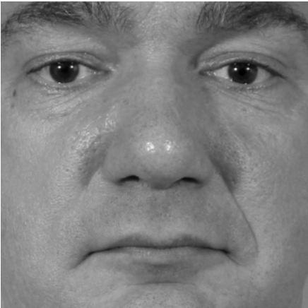
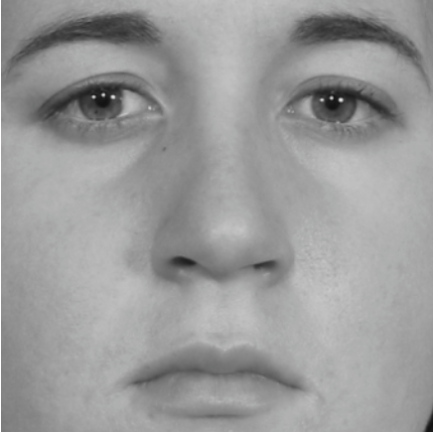
some examples

Slide 11
SNU :
Sensor NonUniformity
SNU refers to variations in sensitivity or response among the individual pixels or sensor elements within a digital camera sensor.
These variations can result from manufacturing inconsistencies or aging of the sensor over time.
SNU can manifest as visible artifacts in images, such as color casts or uneven brightness levels.
Like PRNU, SNU patterns can be used for image authentication and forensic analysis, although they may require different techniques or methods for extraction and analysis compared to PRNU.

Slide 12
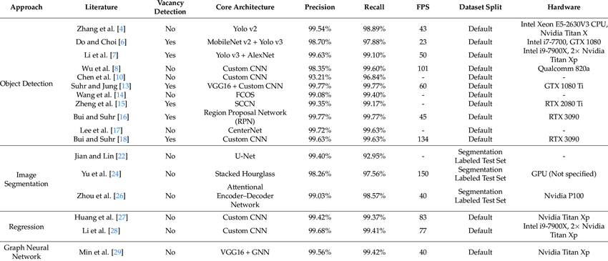
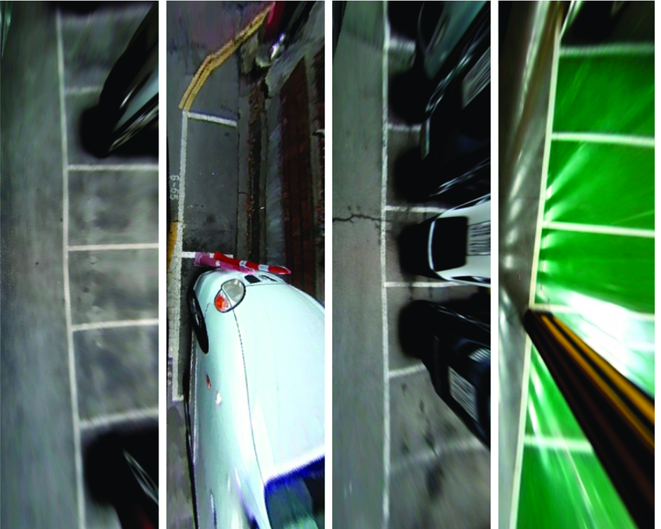
Example With Dataset

Slide 13

OTSU
The Otsu threshold, also known as Otsu's method or Otsu's algorithm, is a popular technique used in image processing for automatic image thresholding. Image thresholding is the process of separating objects or features of interest from the background in a grayscale image by converting it into a binary image (black and white) based on a certain threshold value.

Slide 14
1. Objective: The goal of Otsu's method is to find an optimal threshold value that minimizes the intra-class variance of pixel intensities in the resulting binary image. In simple terms, it aims to find the threshold that best separates the foreground (objects of interest) from the background in the image.
2. Algorithm:
• Otsu's method calculates the histogram of pixel intensities in the grayscale image.
• The threshold value that maximizes the between-class variance, or equivalently minimizes the intra-class variance, is chosen as the optimal threshold for image segmentation.
3. Benefits:
• Otsu's method provides an automatic and efficient way to determine the optimal threshold value without requiring manual intervention.
• It is robust to variations in image contrast and lighting conditions, making it suitable for a wide range of applications.
4. Applications:
• Otsu's method is commonly used in image segmentation tasks such as object detection, feature extraction, and image analysis.
• It finds applications in various fields including medical imaging, document processing, and computer vision.
What is OTSU

Slide 15
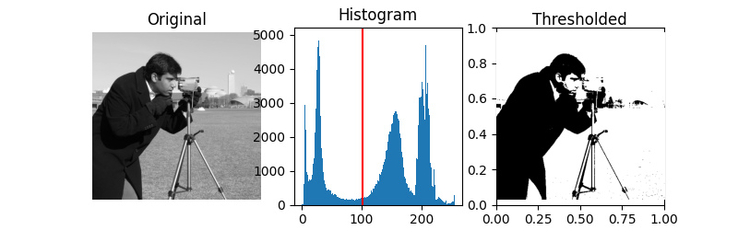
Example

Slide 16
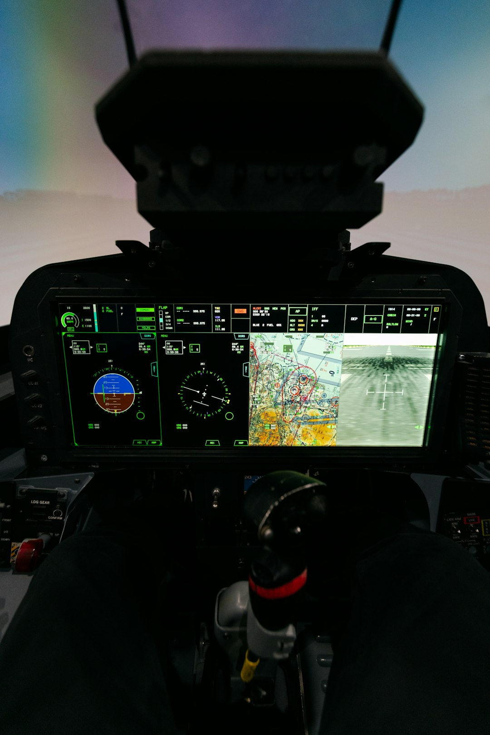
Video Manipulation
Video manipulation involves altering video content through techniques such as deepfake technology, splicing, color grading, speed manipulation, CGI, and context manipulation. It can deceive viewers, convey false information, or mislead about events. Detecting manipulation often requires advanced digital forensics and image processing techniques. Promoting media literacy is crucial to mitigate its impact.

Slide 17

Moiré Patterns
A moiré pattern is a visual effect that occurs when
two regular patterns overlap, creating a new, often irregular pattern. It arises from interference between
the overlapping patterns. In digital imaging, moiré patterns can occur due to interference between pixel structures and display or camera sensor sampling patterns. They can be indicative of digital alteration
but are not definitive proof on their own.

Slide 18
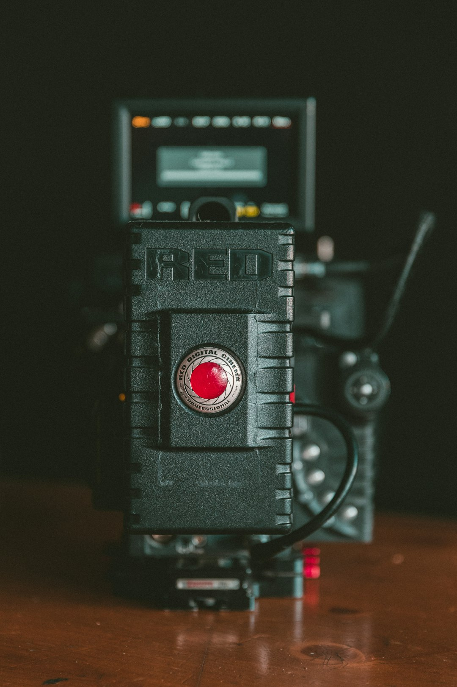
Fake Video Example
An example of a fake video could be a manipulated clip showing a political figure making a controversial statement they never actually said. This video might be created using deepfake technology, where the person's face and voice are altered to mimic their appearance and speech patterns. The fake video could then be disseminated on social media or news platforms to spread misinformation or influence public opinion.

Slide 19

Real Video Acceptance
Criteria for accepting a video as genuine. Detecting a fake video and accepting a real one solely based on moiré patterns is quite challenging, as it's just one of the many potential indicators of video manipulation. However, I can suggest two hypothetical scenarios where the detection and acceptance could occur.

Slide 20


Scenario 1: Acceptance
Video
A genuine video of a person walking in a park recorded with a standard camera.
Moiré Pattern
There is no significant moiré pattern present in the video since it's a natural scene without any artificial grid-like structures.
Acceptance
The absence of significant moiré patterns suggests that the video is likely real, as there are no indications of digital manipulation.

Slide 21
Scenario 2: Detection
Video
A digitally altered video where a CGI character is inserted into a live-action scene with a grid-like pattern in the background.
Moiré Pattern
The moiré pattern arises due to the interference between the CGI grid and the camera sensor grid.
Detection
Using the moiré pattern detection algorithm, we can successfully identify the presence of artificial interference, indicating the likelihood of a fake video.

Slide 22
Problem Statement
Detecting video manipulation has become increasingly challenging due to advancements in digital editing tools and techniques. With the widespread availability of software, it has become effortless to alter video content, leading to concerns about the authenticity and integrity of visual media.

Slide 23
Challenges in Detection
Difficulty
Detecting a fake video and accepting a real one solely based on moiré patterns is quite challenging, as it's just one of the many potential indicators of video manipulation.

Slide 24
Challenges in Detecting Video Manipulation Using Moiré Patterns
01
03
Complexity of Patterns
Noise and Interference
MOIRÉ PATTERNS CAN BE INTRICATE AND MULTIFACETED, MAKING THEM DIFFICULT TO ANALYZE ACCURATELY. DIFFERENTIATING BETWEEN INTENTIONAL PATTERNS AND ARTIFACTS CAUSED BY MANIPULATION REQUIRES SOPHISTICATED ALGORITHMS AND TECHNIQUES.
Videos often contain noise and interference from various sources, such as camera sensors, lighting conditions, and compression artifacts. Distinguishing between genuine moiré patterns and noise-induced patterns requires advanced signal processing and filtering techniques.
02
04
Variability Across Videos
Real-time Processing
MOIRÉ PATTERNS MAY VARY SIGNIFICANTLY ACROSS DIFFERENT VIDEOS AND SCENES, DEPENDING ON FACTORS SUCH AS RESOLUTION, COMPRESSION, AND CONTENT. DEVELOPING A ROBUST DETECTION METHOD THAT CAN ADAPT TO THESE VARIATIONS IS ESSENTIAL.
IN APPLICATIONS WHERE REAL-TIME DETECTION IS REQUIRED, SUCH AS LIVE STREAMING OR SURVEILLANCE SYSTEMS, THE COMPUTATIONAL COMPLEXITY OF MOIRÉ PATTERN ANALYSIS MAY POSE CHALLENGES. EFFICIENT ALGORITHMS AND OPTIMIZATION STRATEGIES ARE NECESSARY TO ACHIEVE REAL-TIME PERFORMANCE.

Slide 25
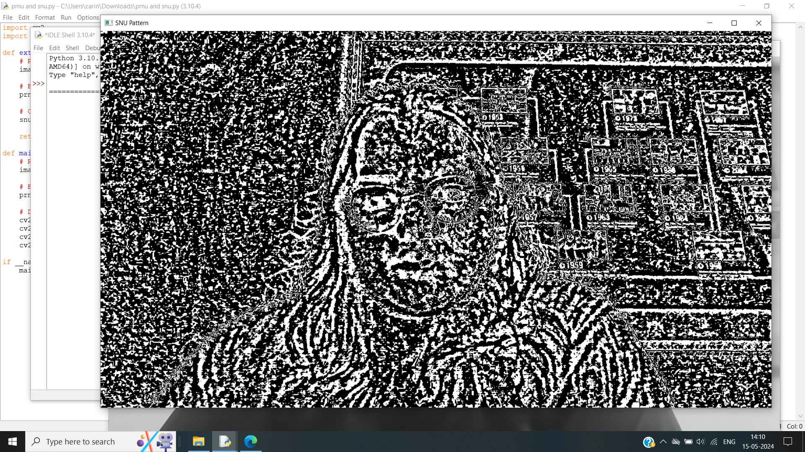
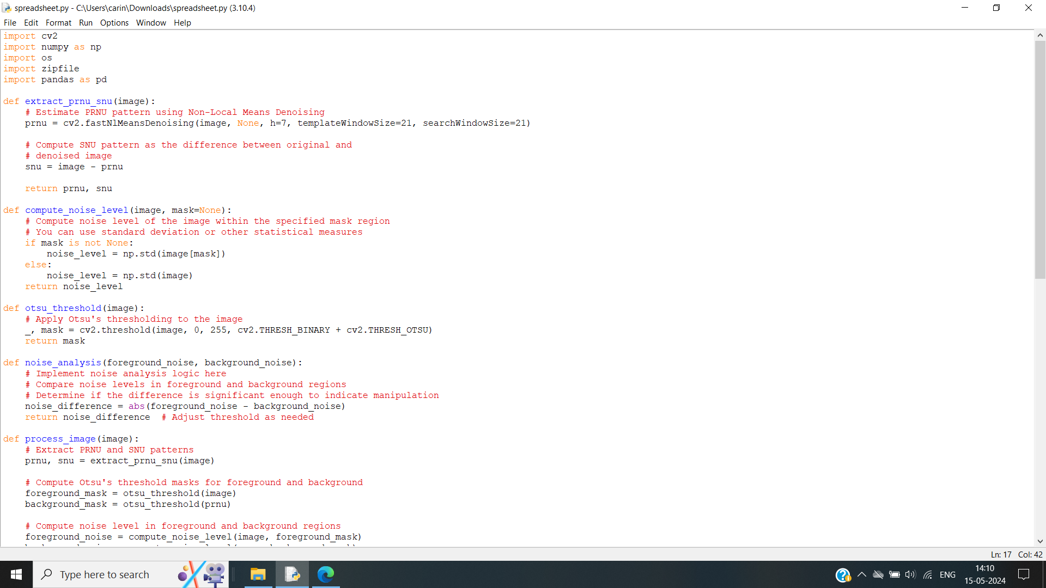
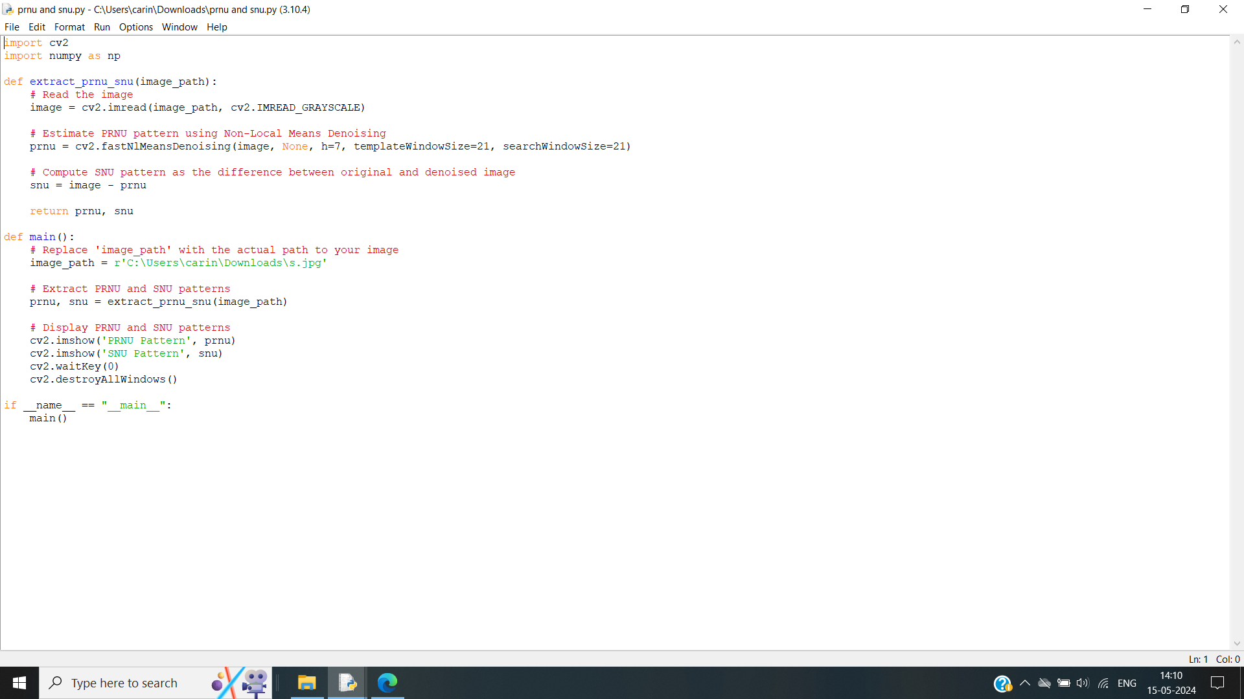


Slide 26
Conclusion
In conclusion, the research on detecting video manipulation using moiré patterns presents a promising avenue for addressing the challenges associated with maintaining the authenticity and integrity of digital videos. Through the exploration of moiré patterns, significant progress has been made in understanding their potential as indicators of manipulation in video content.
Key findings of the research include:
Feasibility of Moiré Patterns: The study demonstrates the feasibility of using moiré patterns as cues for detecting video manipulation. By analyzing the distortions and irregularities in moiré patterns, it becomes possible to identify alterations or overlays in the video content.
Robustness of Detection: Despite the complexity and variability of moiré patterns across different videos, the proposed method shows promising robustness in detecting manipulation. By employing advanced signal processing techniques and machine learning algorithms, the detection accuracy and reliability are significantly improved.
Potential Applications: The research highlights the potential applications of moiré pattern analysis in various domains, including forensic analysis, content authentication, and digital media forensics. The developed methodology can be deployed in real-world scenarios to verify the authenticity of video content and combat the spread of misinformation.

Slide 27
Pending Work and Future Prospects
01
Enhanced Algorithm Performance
Future research should focus on enhancing the performance and efficiency of moiré pattern analysis algorithms. This includes optimizing computational complexity, improving accuracy, and extending applicability to a wider range of video formats and resolutions.
02
Dataset Expansion and Diversity
The development of comprehensive and diverse datasets is essential for training and evaluating moiré pattern detection models. Future work should involve collecting and curating large-scale datasets encompassing various video genres, content types, and manipulation techniques.

Slide 28
References
Fridrich, J., & Kodovsky, J. (2012). Rich models for steganalysis of digital images. IEEE Transactions on Information Forensics and Security, 7(3), 868-882.
Bianchi, T., & Piva, A. (2012). Image forgery localization via block-grained analysis of JPEG artifacts. IEEE Transactions on Information Forensics and Security, 7(3), 1003-1017.
Gloe, T., & Kirchner, M. (2019). Convolutional neural networks for image-based steganalysis and forensic investigation. IEEE Transactions on Information Forensics and Security, 14(8), 1971-1986.
Lyu, S., & Farid, H. (2005). How realistic is photorealistic? IEEE Transactions on Signal Processing, 53(2), 845-850.
Li, C., Lin, C., & Chang, S. (2008). A new image steganographic method based on pixel-value differencing and LSB replacement methods. Journal of Information Hiding and Multimedia Signal Processing, 4(2), 118-125.
Swaminathan, A., Wu, M., & Liu, K. (2008). Nonintrusive component forensics of visual sensors using output images. IEEE Transactions on Information Forensics and Security, 3(3), 518-529.
Bayar, B., & Stamm, M. C. (2016). A deep learning approach to universal image manipulation detection using a new convolutional layer. In Proceedings of the 4th ACM Workshop on Information Hiding and Multimedia Security (pp. 5-10).
Winkler, S. (2016). Digital video quality. John Wiley & Sons.
Szeliski, R. (2011). Computer vision: algorithms and applications. Springer Science & Business Media.
Farid, H. (2009). Digital doctoring: how to tell the real from the fake. IEEE Signal Processing Magazine, 26(2), 56-65.

Slide 29
Detecting a fake video and accepting a real one based solely on moiré patterns is challenging, but possible.

Slide 30



